Slide 1
TIMETABLE SUPPORT Custom Schedules

Slide 2
Enrolment Appointments
When you log into myStudent Centre, you can view the date when your schedule is viewable, as well as the date of your enrolment appointment.
Enrolment Appointment: This is the date you can actually enrol in classes.

Slide 3
Academic Requirements
Check your Academic Requirements report before creating or editing your schedule. This will make sure you're on track to satisfy your Program Requirements and graduate as well as speeding up the enrolment process.

Slide 4
Type of Schedule Depending on your program, you will be issued with an Assigned Schedule or a Custom Schedule.
Assigned Schedule
Custom Schedule
With assigned schedules, students will be issued a schedule prepopulated with courses.
Build My Schedule link in myStudent Centre lets you find your perfect schedule fast and easily!

Slide 5
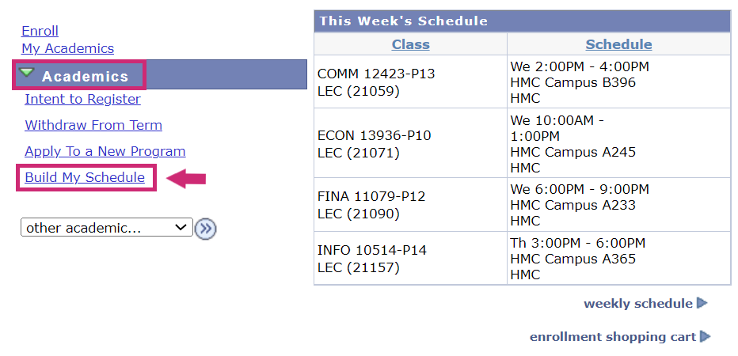
Visit myStudent Centre to determine if you have access to the Build My Schedule link.

Slide 6
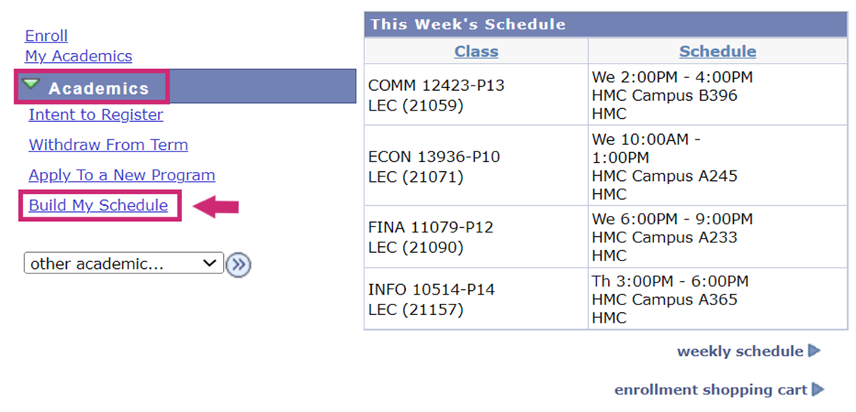
If you do NOT have access to Build My Schedule link, please use Enrolment Shopping Cart and follow instructions to add/swap/drop courses.

Slide 7
Build My Schedule: Step-By-Step Instructions
Students enrolled in course-based programs will be able to use Build My Schedule to create their schedule for the term.
Log in to myStudent Centre
Under the Academics section, click Build My Schedule

Slide 8
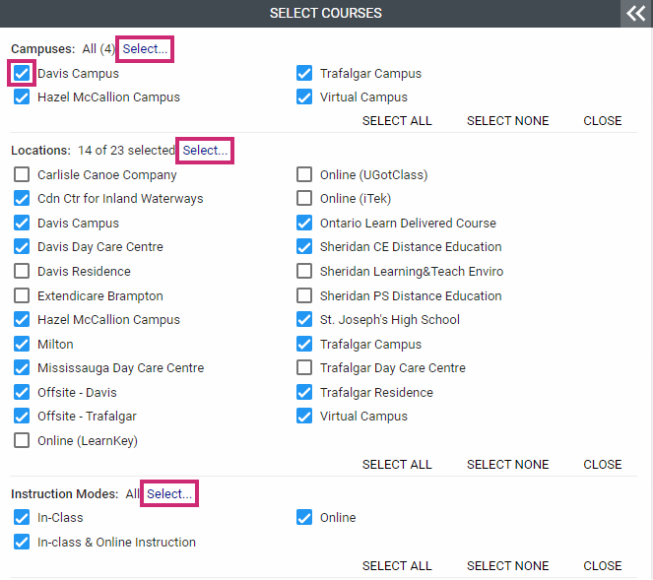
Select the term you wish to enroll in
Click the Select… button to expand your filter options
Filter your results based on your preferences by using the checkboxes
Filters can be changed at any time to expand or limit your options.

Slide 9
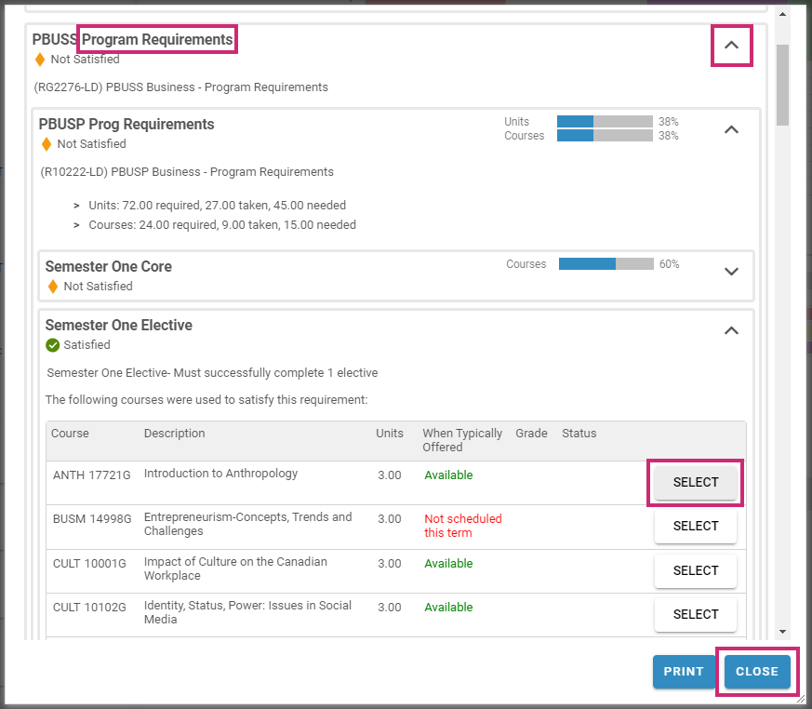
Click on MY REQUIREMENTS below the filtering section
2.A pop-up window will open with all of your available courses.
3.Use the dropdown arrows to display different courses available to you based on your requirements.
4.Click the SELECT button beside the course you wish to add to your schedule.
5.Once you have selected your courses, click the CLOSE button.
6.Courses can be removed by clicking on the Trash Bin.

Slide 10
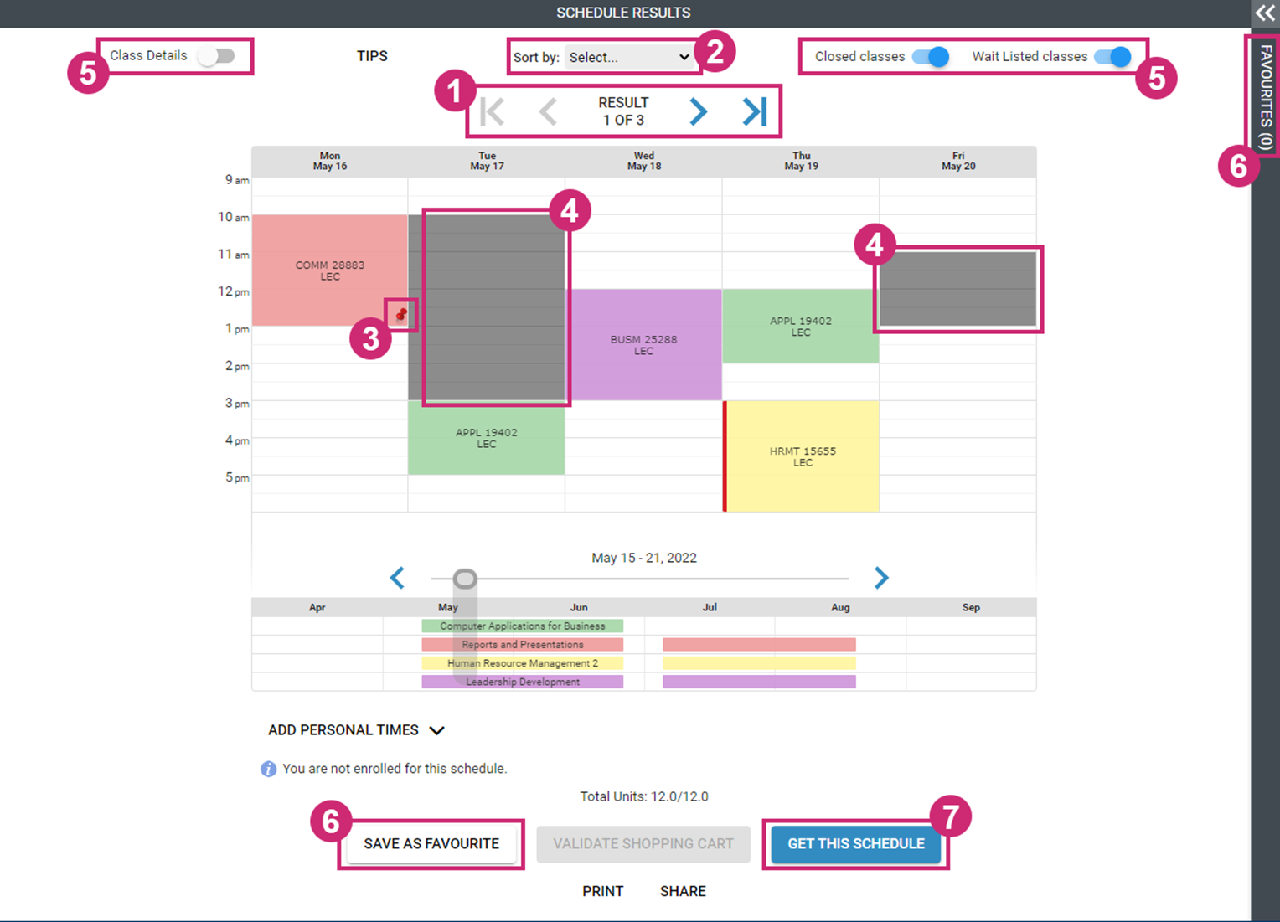
Schedule Results
Use the arrows to view your schedule options
Build your schedule based on one of these criteria
Pin a course in place by clicking on it – the course will not move when you shuffle through results
Visually block off days and times that don’t work with your personal schedule
Toggle between Class Details, Closed classes, and Wait Listed classes
Save your favourite schedules to return to at a later time
Once you are happy with your schedule, click the GET THIS SCHEDULE button

Slide 11
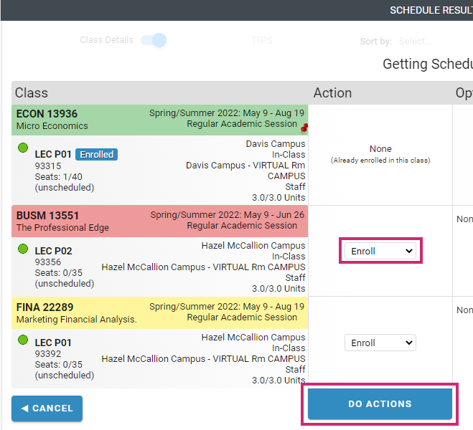
Confirm Your Schedule:
1. From the dropdown menu, select Enroll
2. Click the DO ACTIONS button to confirm your courses

Slide 12
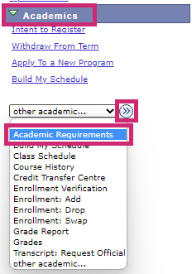
Confirm your Academic Requirements in myStudent Centre
Log in to myStudent Centre.
2.Under the Academics section, open the dropdown menu and select Academic Requirements, then click (≫).

Slide 13
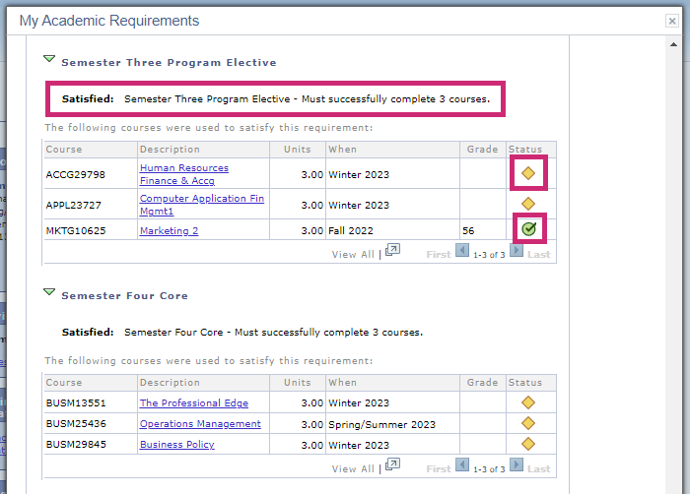
Ensure that you have selected the electives necessary to satisfy your program requirements. The yellow diamond indicates In Progress and the green check mark indicates Taken.

Slide 14
Choose your Electives
Depending on your program, you will either enrol in a General Elective, a Program Elective or a Breadth Elective.
Elective places are limited and assigned on a first come, first served basis - so it is strongly recommended that you enrol in your elective as soon as possible.
Once cross-campus enrolment opens, more options may become available to you. However, it's recommended that you select an elective as soon as possible in case your preferred option isn't available.

Slide 15
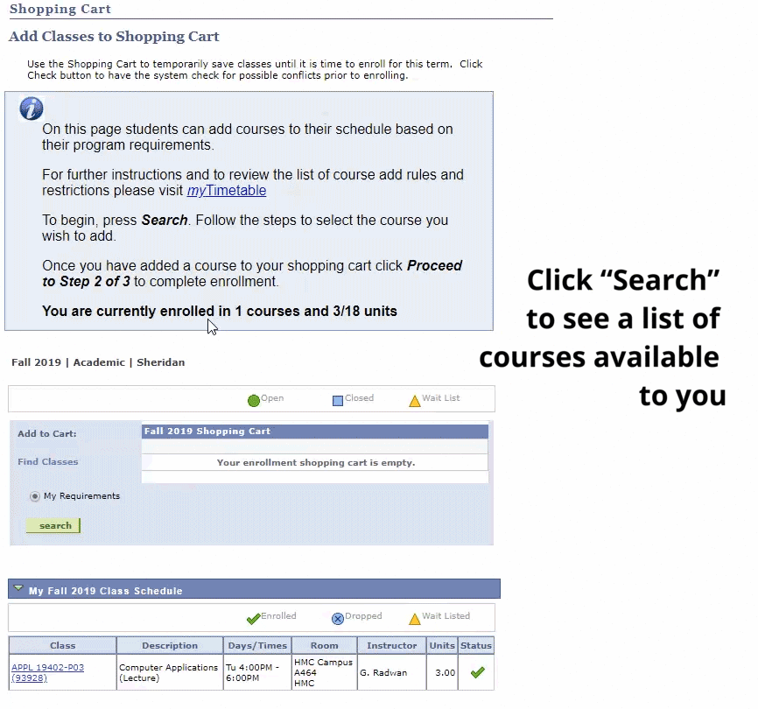

Slide 16
Finding your classes
It's especially important to become familiar with the location of your classes, as some may not located on your home campus.

Slide 17
If you see a room number in your schedule, it means that you have a face-to-face class on campus.
If you see Virtual Campus Remote, it means that you have a virtual (remote) class.

Slide 18
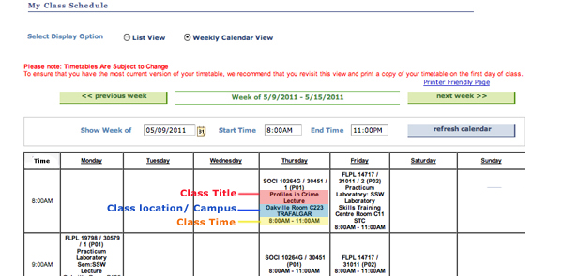
The visual below will help you to understand your schedule:

Slide 19
Delivery Modes
In-Person: All courses are on campus and students must attend in person.
Remote: All courses are delivered virtually; no in-person components.
Hybrid: Students will have a combination of In-Person and Remote course sections. Some of the in-person portions/courses must be attended on campus and are mandatory.

Slide 20
SLATE – slate.sheridancollege.ca
Log into SLATE to view course info and materials and see how your course is being delivered (remotely, synchronously, asynchronously).
If you swap, drop or add a course it may take 1-2 days to appear in SLATE. Be sure to first check that the course appears in your schedule in myStudent Centre.
If the course appears in your schedule in myStudent centre but is not accessible on SLATE after 2 business days, please inquire with your course instructor.

Slide 21
How to drop a course
Step 1: Open Course Drop in myStudent Centre Select Enrolment: Drop from the Academics drop down menu and hit the ›› button
Step 2: Select class to drop To begin, select the classes you wish to drop and click "Drop Selected Classes". If you are unsure, please contact your Program Advisor before dropping a class.
Step: 3 Confirm drop On the next screen you will be asked to confirm the drop.
Step 4: Review drop confirmation You will receive confirmation if your drop has been successful or not.

Slide 22
The system won't allow me to enrol in the class I want. Why?
There are a few different reasons why you may not be able to select a class:
Exclusions: Some of our GenEd classes overlap with the required classes in some Sheridan programs. If a GenEd class repeats program content, then students cannot enroll in that particular class since GenEd classes need to introduce students to ideas and concepts outside of their program.
Reserve Capacity: Some GenEd classes are reserved for specific program areas and may not be open to all students.
After Day 10: Students cannot enroll online after Day 10 of the new semester. If you still need a GenEd after Day 10, you will need to see your Records Specialist in the Office of the Registrar.

Slide 23
Full Enrollment
Once a class is full, you can monitor the class enrollment to see if a space opens up, but make sure that you enroll in another class in the meantime. Many of the GenEd courses fill quickly, so register early to give yourself the most options to pick from.

Slide 24
In-person service hub
Sheridan's In-Person Service Hub
If you’ve got questions, we’ve got answers! Each campus has experienced staff to help you at the Service Hub! Let us help you with your schedule and course registration, admissions, finances, academic requirements, graduation, and more!
Hours of Operation:
Monday - Friday 8:30am - 4:30pm
TRAFALGAR | DAVIS | HMC
A134a (Near Tim Hortons) | B-Wing, Main Entrance area (In front of the Centre for Student Success, Rm. B230) | A-Wing, Main Entrance area (In front of Rm. A147)

